Slide 1
Housing project Presented by :- Ruchita Parmar

Slide 2
Contents
Problem statement and understanding.
EDA steps and visualizations.
Assumptions used to complete the project, analysis.
Conclusion.

Slide 3
Problem Statement & Understanding
There were many basic Human requirement where sheltering is one of the most important. Due to rapid increase in population there is a situation where prices were increasing with high pace. There were many factors and features of housing which affect the prices and plans of individuals. Nowadays the real estate market is a standout amongst the most focused regarding pricing and keep fluctuating. People are looking to buy a new home with their budgets and by analysing market strategies. But main disadvantage of current system is to calculate a price of house without necessary prediction about future market trends and result is price increase. So, the main aim of our project is to predict accurate price of house without any loss. The problem statement was to predict the price of houses from the dataset with features as below:-
Date house was sold, Price, Bedrooms, Sqft_Living, Sqft_Lot, Floors, CentralAir, LotFrontage, LandContour, Utilities, Neighborhood, HouseStyle, Electricals, GarageArea, etc.

Slide 4
Problem Statement & Understanding
Background of the study
Our goal is to solve the regression problem where the target variable is the price and the independent variables are number of bedrooms, number of bathrooms, super built up area, carpet area, furnishing status, floor type, direction facing, type of apartment, region and facilities.
The application of machine learning in property research is still at an early stage. We hope this study has moved a small step ahead in providing some methodological and empirical contributions to property appraisal, and presenting an alternative approach to the valuation of housing prices.

Slide 5
Problem Statement & Understanding
We then apply advanced machine learning algorithms such as Random forests. We need to understand the scope of problems and the benefits related to strategic, conceptual and implementation alternatives as our study and price prediction benefits to an improved approach will extend beyond low-income beneficiaries.
New analytical techniques of machine learning can be used in property research. This study is an exploratory attempt to use three machine learning algorithms in estimating housing prices, and then compare their results.
Many conventional estimation methods produce reasonably good estimates of the coefficients that unveil the relationship between output variable and predictor variables. Although machine learning can produce model predictions with tremendously low errors, the estimated coefficients derived by the models may sometimes make it hard for interpretation.

Slide 6
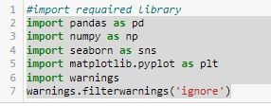
EDA steps and visualizations
Data visualization is easy to perform EDA which makes it easy to make others understand our analysis.
Table of Content for dataset visualization.
1. Study of Variables – At first, let us import the necessary libraries used and then train and test dataset.

Slide 7
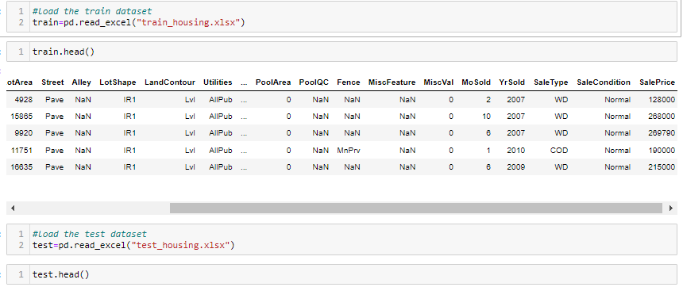
EDA steps and visualizations

Slide 8
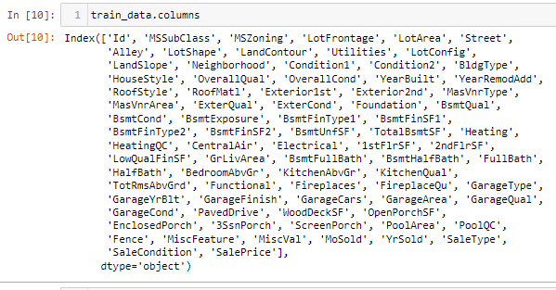
EDA steps and visualizations
Now, let's check the columns in the table, to have a mental picture of what we have in hand.

Slide 9
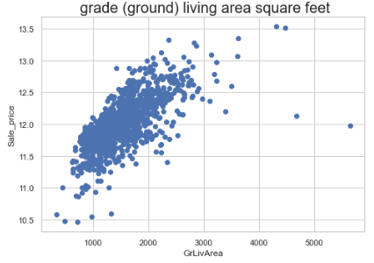
EDA steps and visualizations
Target Variables – The fact that we should consider when we are buying a house is the Living Area. So let's analyze the relationship between the Living area and the target variable ‘SalePrice’.

Slide 10
EDA steps and visualizations
From the above plot, the Living area and Sale Price have roughly a linear relationship. The two dots on the top indicate a sudden price increase. It may be because the house is located in a hot spot. Also, note that the two dots on the right-bottom where the GrLivingArea is more and the SalePrice is very less. These were outliers that needs to get deleted as these will impact the model performance.
Null and Missing Values Study – Lets first find the missing value in the dataset. Although these variables not so important but let’s not drop them and fill the missing values with 0 or None and proceed with modeling.

Slide 11
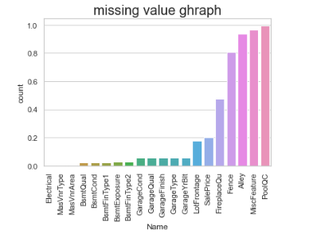
EDA steps and visualizations
Data Cleaning - We fill the missing values by 0 if the type of the input is an integer, and we fill ‘None’ if it’s categorical. Later we will use a label encoder for converting these categorical variables into a numerical form.

Slide 12
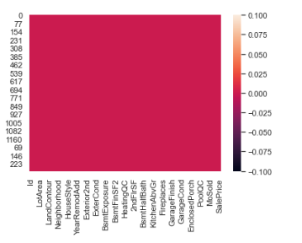
EDA steps and visualizations
Remove null /missing values Now there are no missing values present in the dataset

Slide 13
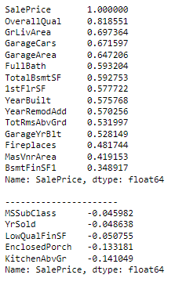
EDA steps and visualizations
Correlation Study - We have 80 columns in our data set. Visualizing all the data takes a lot of time, so we consider the variables which are highly correlated (both positive and negative) with our target variable “SalePrice”
.

Slide 14
Assumptions
Worked on assumptions that these are all the measurable data that affect a home's price. There were more parameters that matters as well such as house conditions, locations, locality favoritism and etc. But these parameters are more subjective and almost impossible to measure and ignoring them.

Slide 15
conclusion
The question for this Housing price prediction is to study how well house prices can be predicted by using k-Nearest neighbor and Random forest regression.
We have found that the Random forest regression algorithm performs
better at predicting house prices than the k-Nearest neighbor algorithm. There is still a difference between the actual prices in our testing data and the prices predicted by the Random forest regression algorithm.

Slide 16
conclusion

